Slide 1
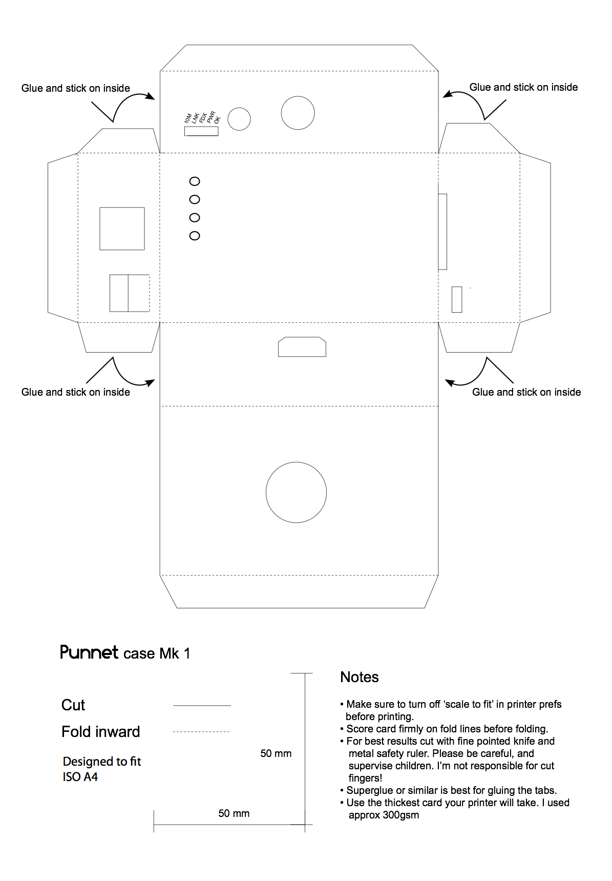

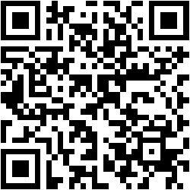




Yeah!
Active
Yeah!
Mobile
Programmatic
Data
Targetometer
1x Update
2x Contact

